Slide 1
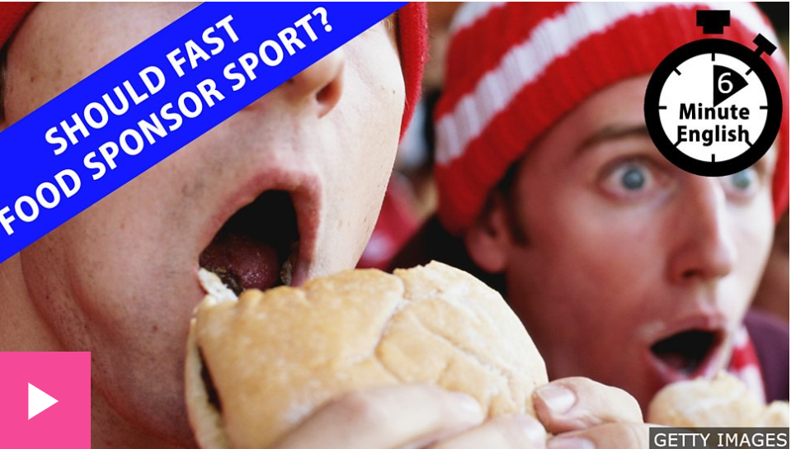
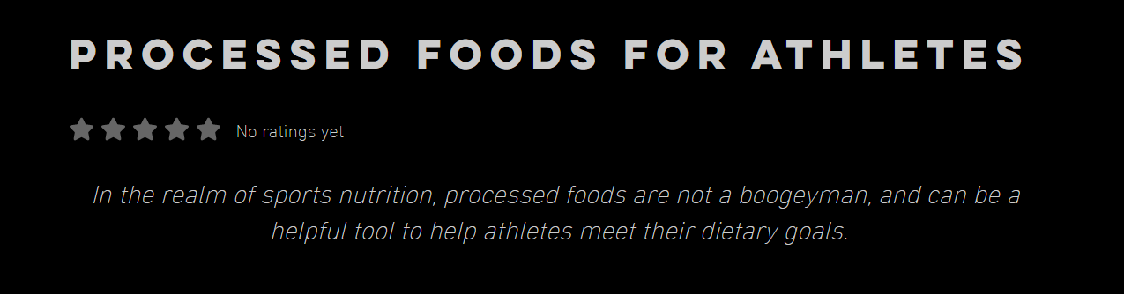
Ultra-processed foods in sports nutrition
Professor Louise Burke
Chair of Sports Nutrition Mary MacKillop Institute for Health Research
Australian Catholic University

Slide 2
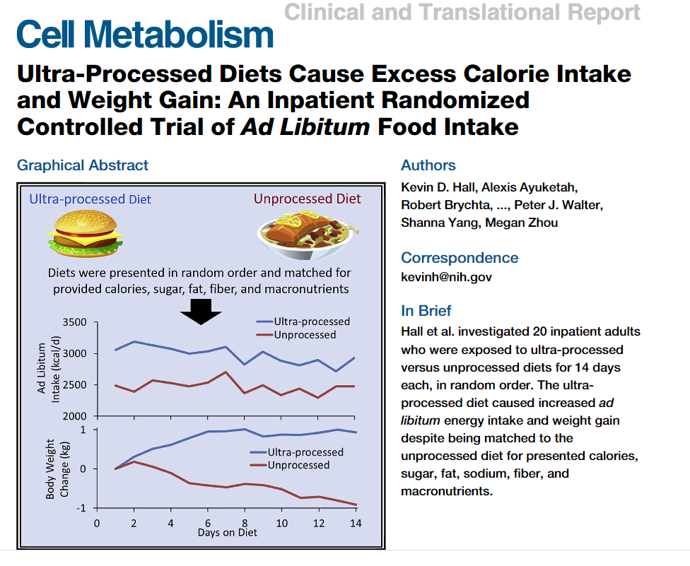
ULTRA PROCESSED FOODS IN THE NEWS
In this large prospective study, a 10% increase in the proportion of UPF was associated with a significant increase of > 10% in risks of overall and breast cancer.
Fiolet et al. BMJ 2018;360:k32
In this large observational prospective study, higher consumption of UPF was associated with higher risks of cardiovascular, coronary heart, and cerebrovascular diseases
Srour et al. BMJ 2019;365:l1451
Hall et al. Cell Metab 2019; 30: 67-77

Slide 3
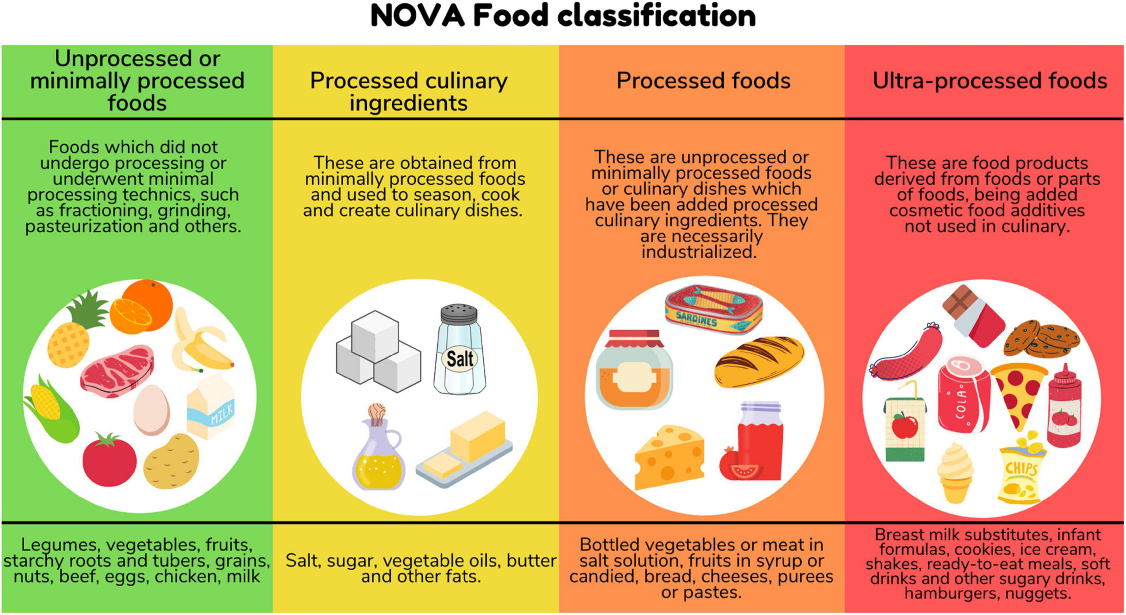
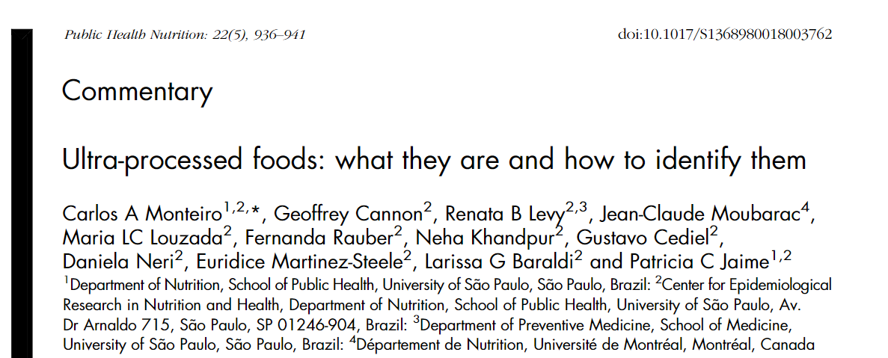
ULTRA PROCESSED FOODS
- THE NOVA SYSTEM
Industrial processing
Formulations from substances derived from foods and additives, including novel food ingredients
Hyper-palatable
Long shelf life and packaging
Low cost/high profit margin

Slide 4
Ultra-processed foods in sports nutrition
Professor Louise Burke Chair of Sports Nutrition Mary MacKillop Institute for Health Research
Australian Catholic University

Slide 5
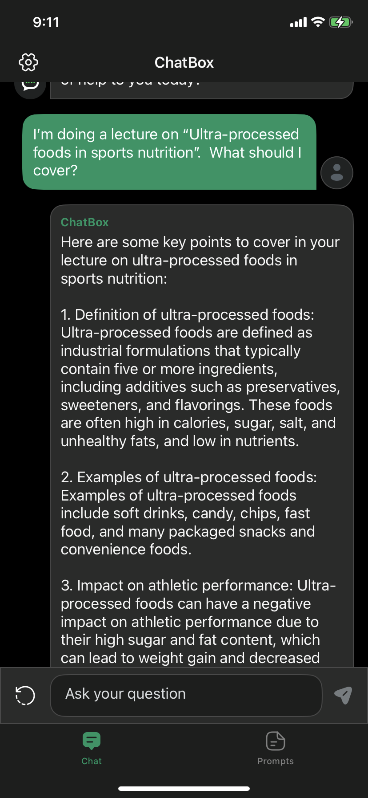
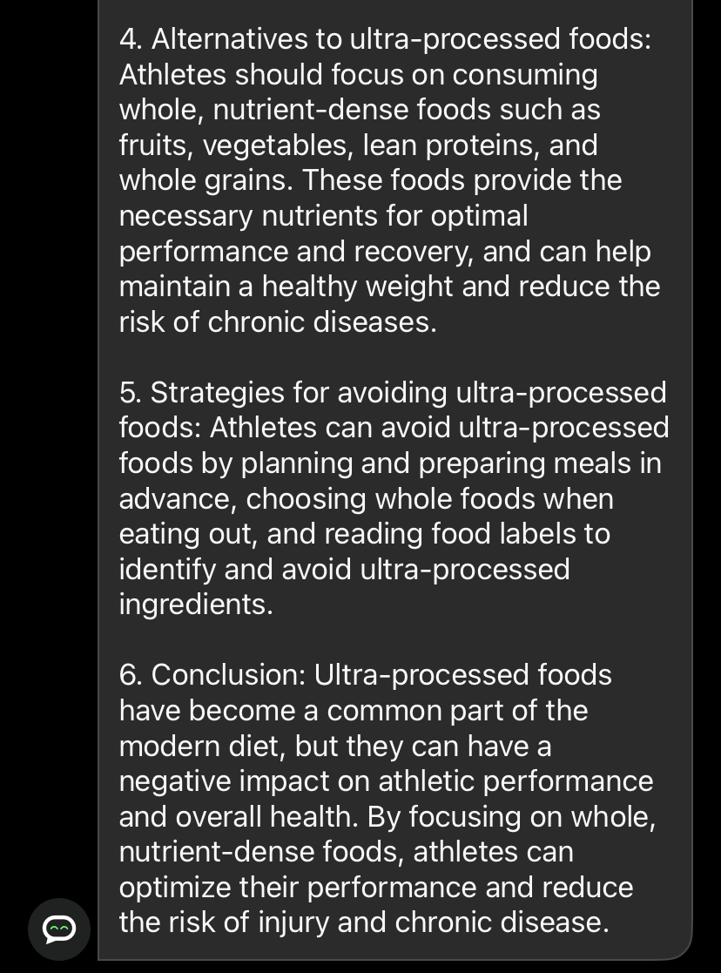

Slide 6
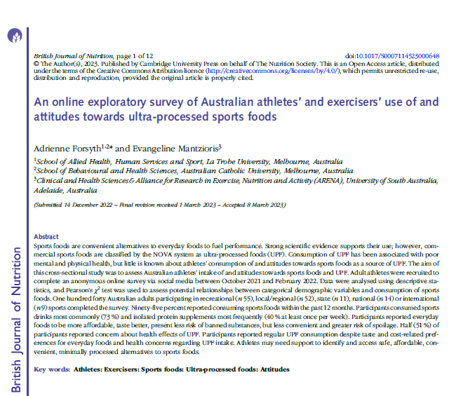
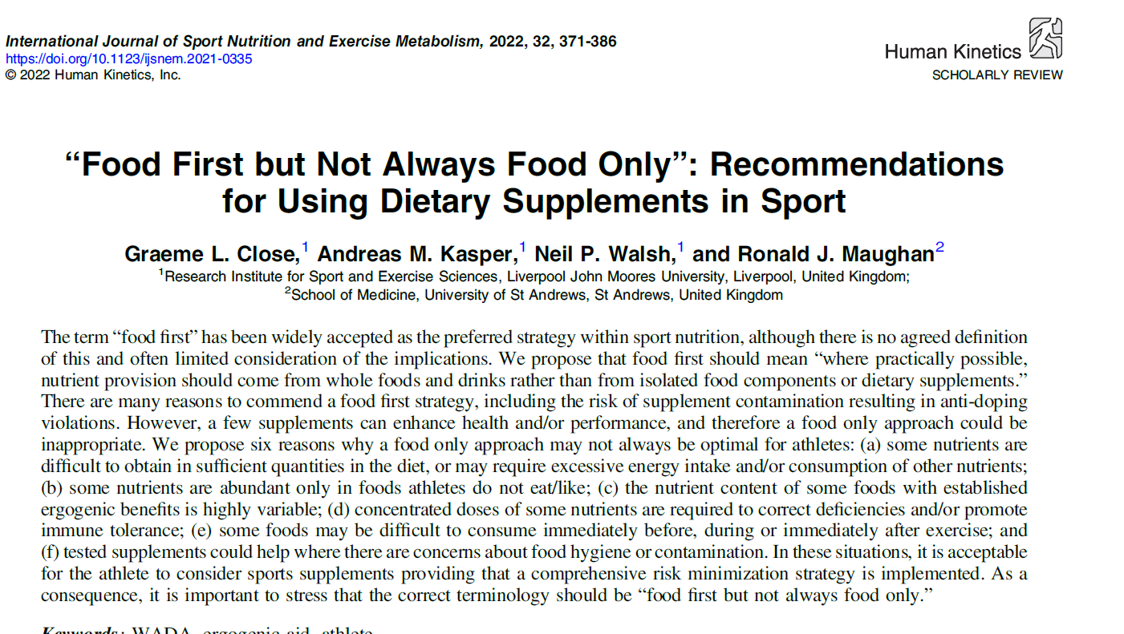
VALUABLE RESOURCES
Forsyth & Mantzioris, Br J Nutr. 2023; doi:10.1017/S0007114523000648
Close et al. Int J Sport Nutr Exerc Metab. 2022; 32: 371-386

Slide 7
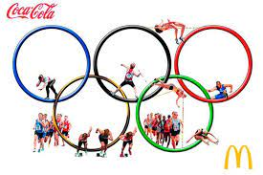
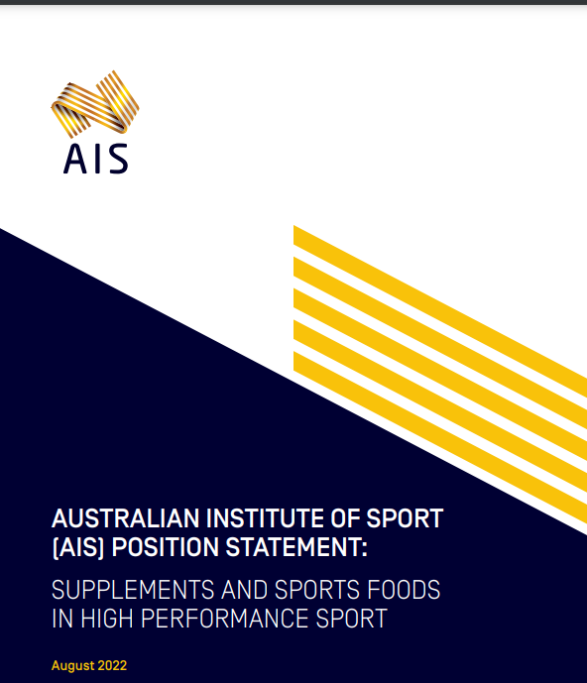
MY DEFINITION OF (ULTRA)-PROCESSED
FOODS IN SPORTS NUTRITION
SPORTS FOODS
UPF/PF USED BY ATHLETES
Specialised products used by athletes to provide a convenient source of nutrients when it is impractical to consume everyday foods to meet sports nutrition goals.
UPF/PF consumed by athletes within their general diets, or for sports-related uses
Sports drinks
Sports gels
Sports confectionery
Sports bars
Protein powders
Liquid meals

Slide 8
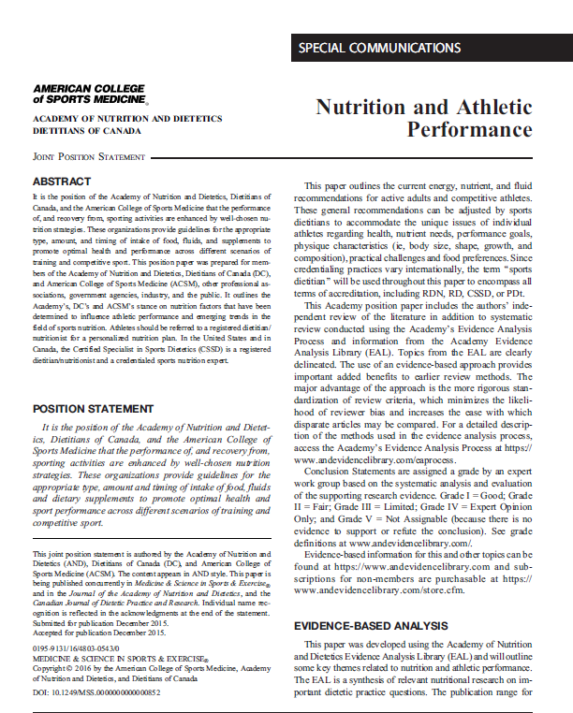
uPF may bridge the gap between sports nutrition goals and intake from “WHOLE” foods
Sports nutrition guidelines provide robust guidelines for amounts, types and timing of nutrients and food constituents, often around exercise
Whole foods may not contain sufficient (or recognisable) amounts of nutrient needs
The food environment or opportunities to consume whole foods and fluids may not align to needs
Safety
GI limits
Food or eating
restrictions
Known/suitable
nutrient content
GI considerations may limit intake of sufficient amounts of whole foods

Slide 9
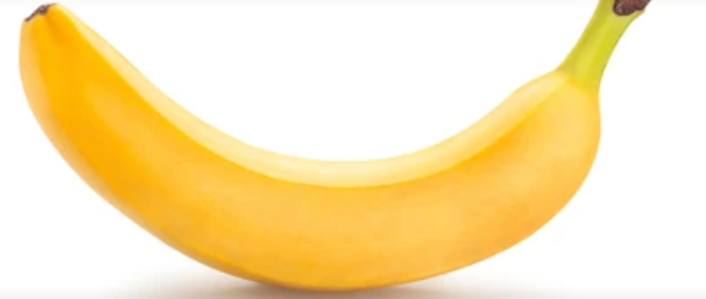
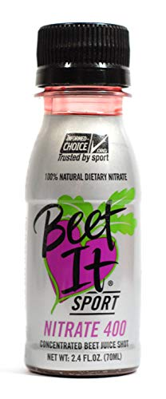
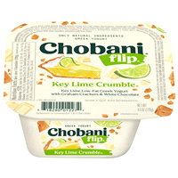
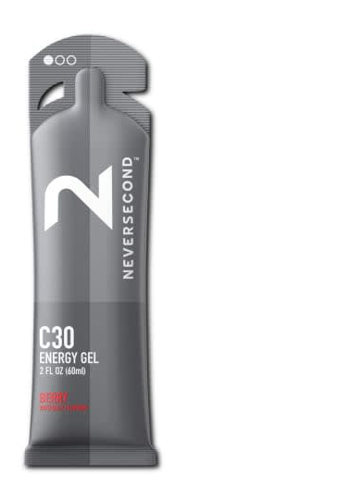
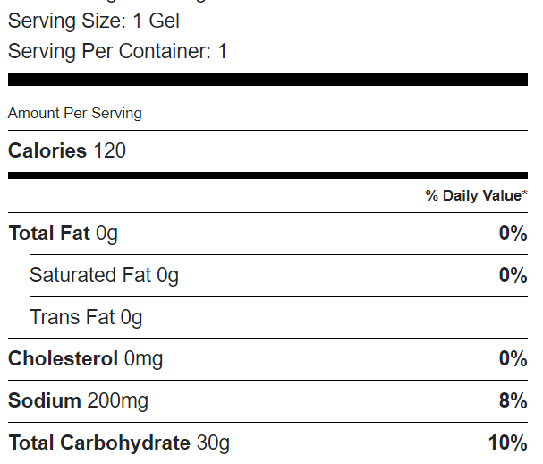
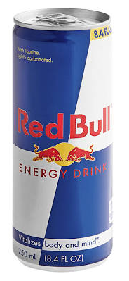
CHARACTERISTICS OF UPF MAY ADDRESS SPORTS NUTRITION TARGETS
Coffee | Mean caffeine | Range
Short black coffee* (variety of outlets) | 107 mg | 25-214 mg
250 ml brewed coffee (same outlet different days) |  | 130-282 mg
FOOD LABELS IDENTIFY NUTRIENT QUANTITIES
PACKAGED TO PROVIDE USEFUL NUTRIENT AMOUNTS
*Desbrow Food Chem Toxicol. 2007;45(9):1588-92.
FORMULATED TO INTEGRATE SEVERAL NUTRIENT GOALS
CONSISTENT COMPOSITION

Slide 10
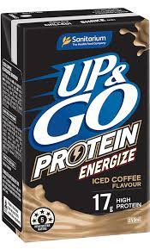
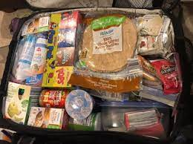
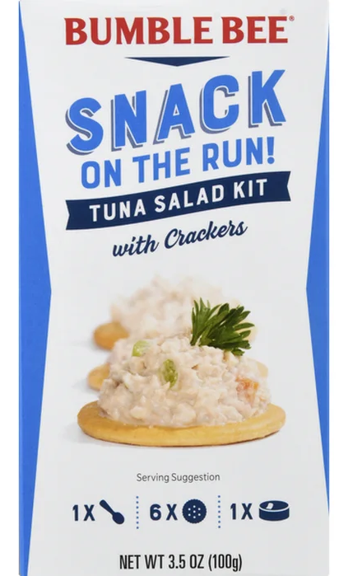
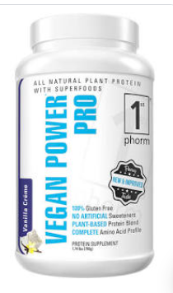
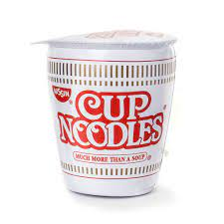
CHARACTERISTICS OF UPF MAY ENHANCE ATHLETE’S FOOD ENVIRONMENT
MINIMAL STORAGE/ HANDLING REQUIREMENTS
PORTABLE AND TRANSPORTABLE
UBIQITIOUS – FOUND IN MANY ENVIRONMENTS
MAY RESCUE A POOR FOOD ENVIRONMENT OR A FUSSY EATER

Slide 11
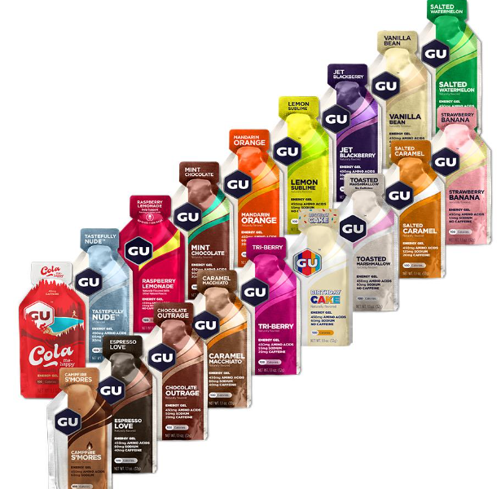
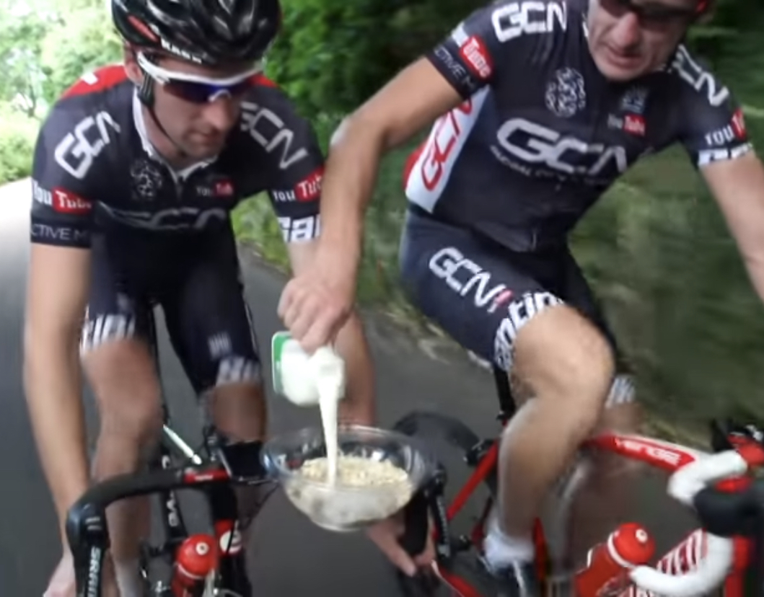
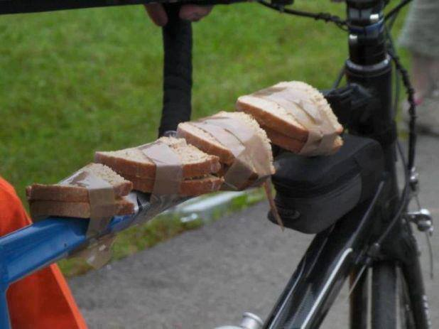
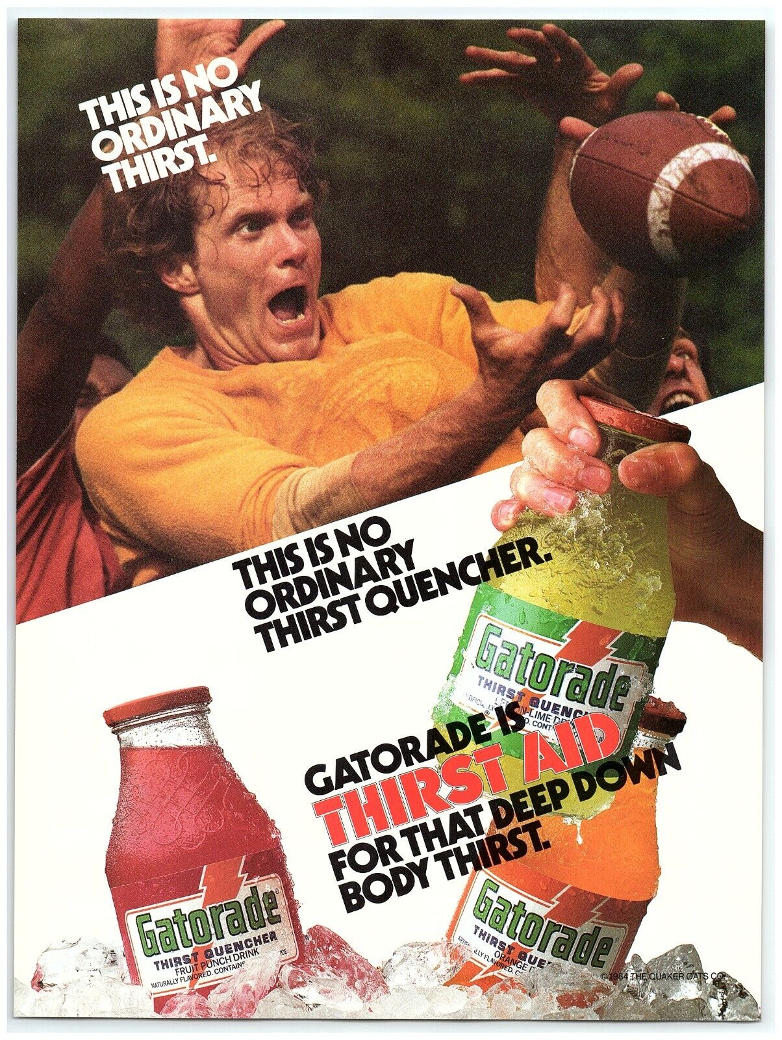
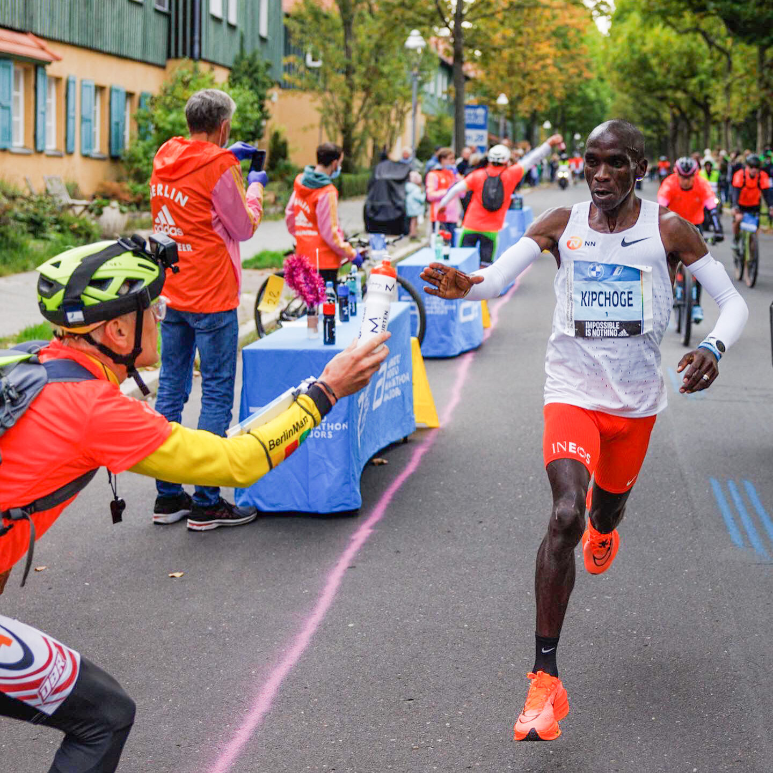
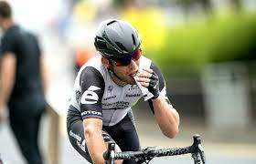
CHARACTERISTICS OF UPF MAY ENHANCE NUTRIENT CONSUMPTION
Male Athletes | Technique | Mean EE
Grand Tour cyclists (Giro D’Italia) | DLW | 32.3 ± 3.4 MJ/d 28.9 ± 3.2 MJ/d
X Country skiiers (training) | DLW | 30.3 ± 4.2 MJ/d
30-35 g
protein
FLAVOUR/HEDONIC CHARACTERISTICS MAY STIMULATE APPETITE OR OVERCOME APPETITE FATIGUE
COMPACT FORM OF NUTRIENT INTAKE – SMALLER VOLUME
Sjodin et al IJSM 1994; Plasqui et al. MSSE 2019
EASIER HANDLING FOR INTAKE DURING EXERCISE

Slide 12
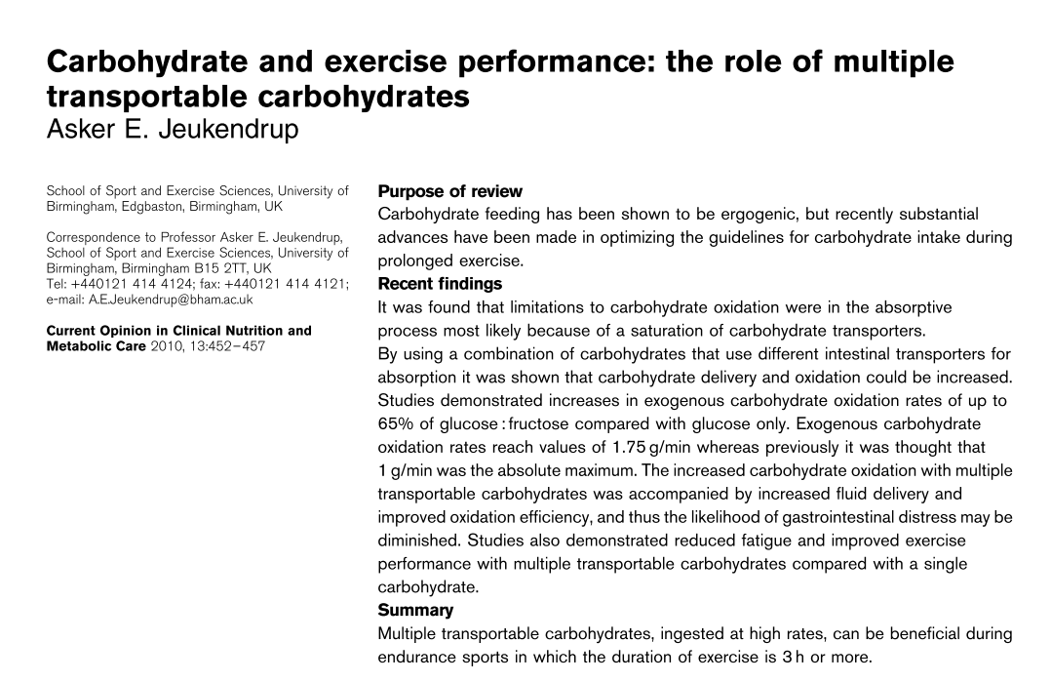
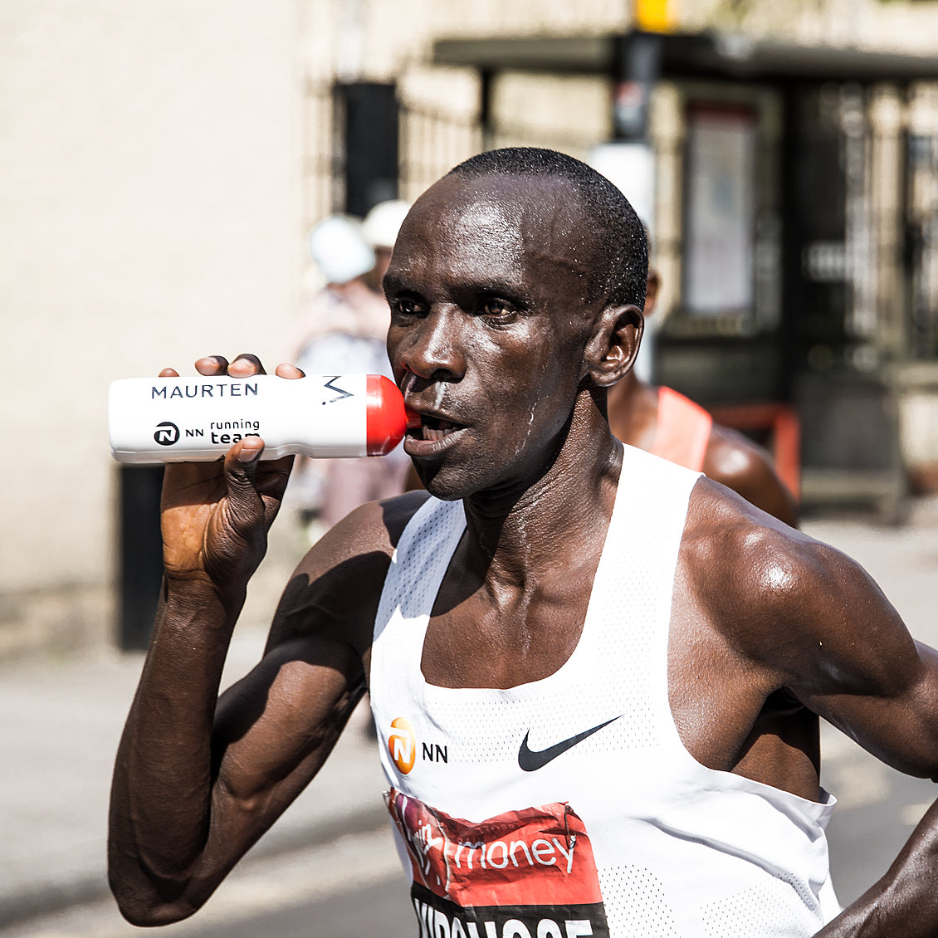
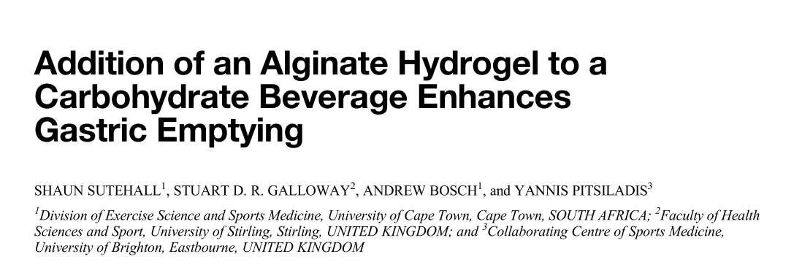
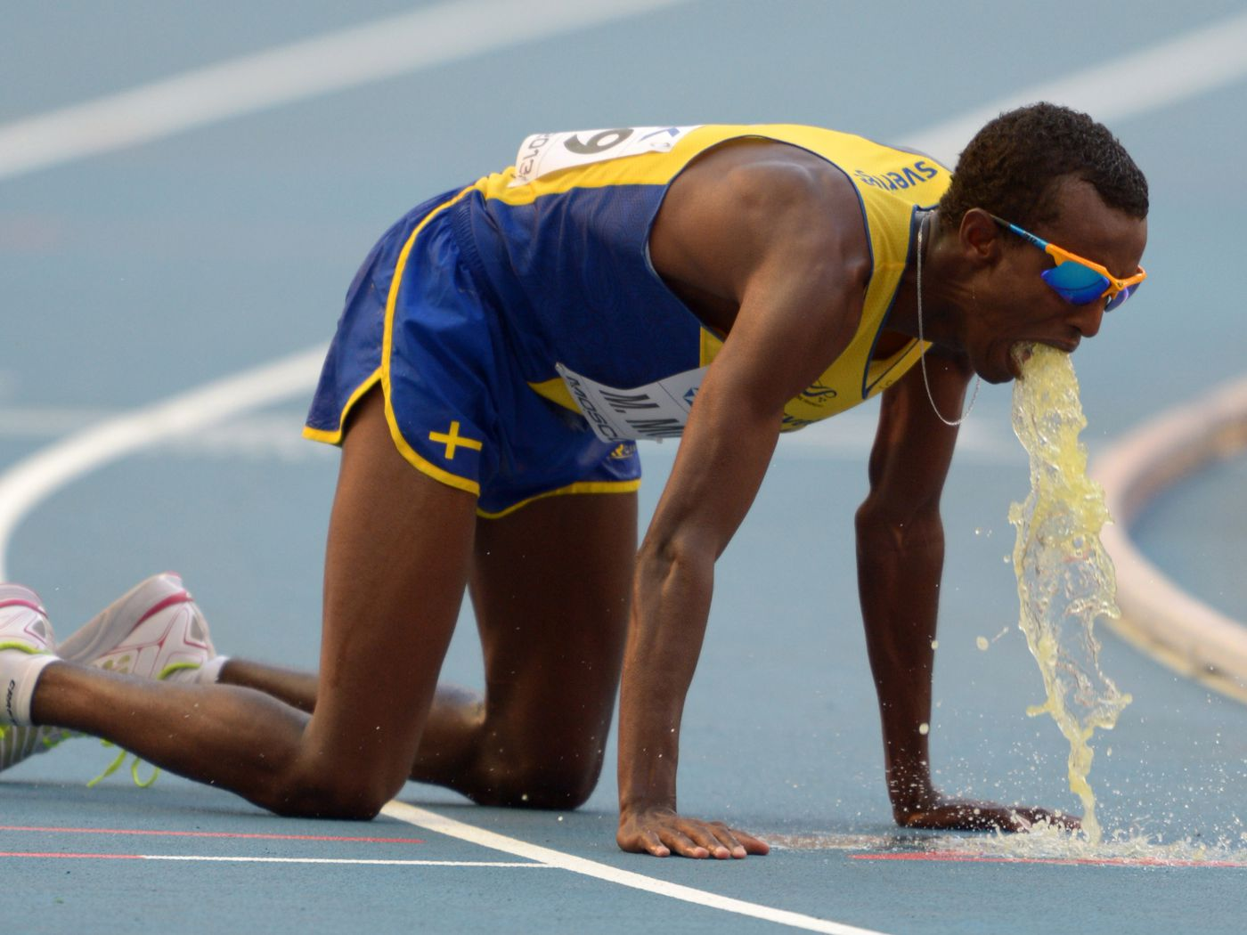
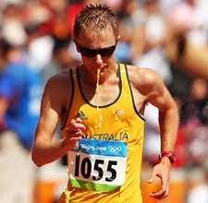
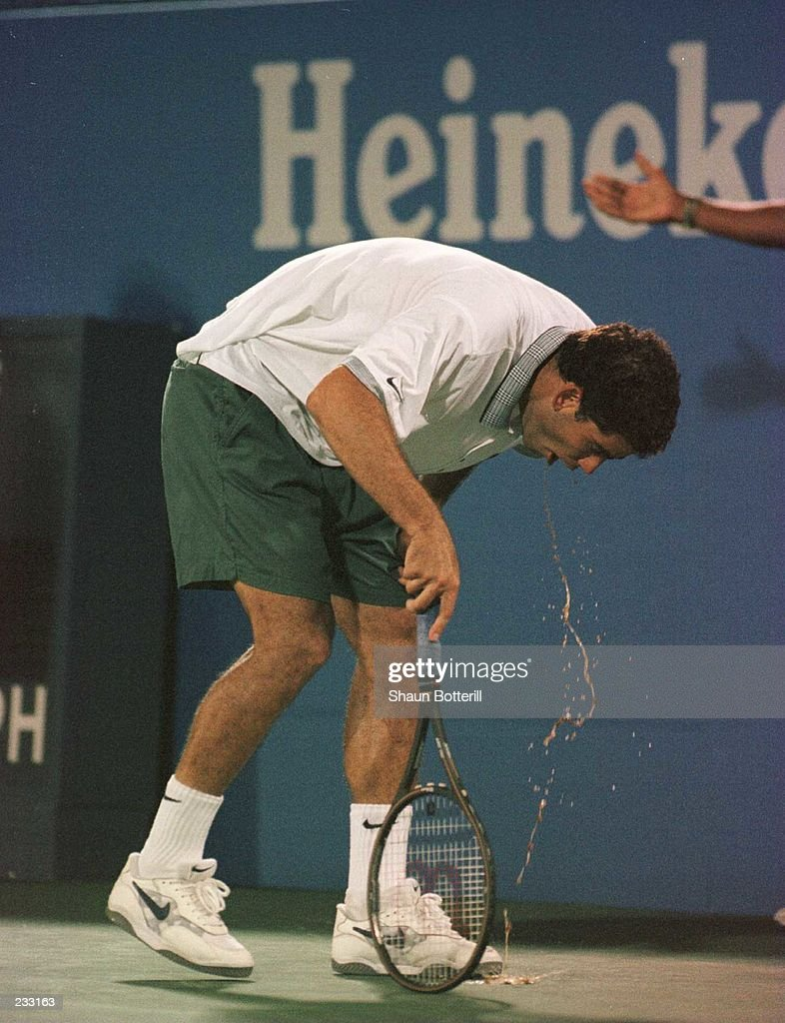
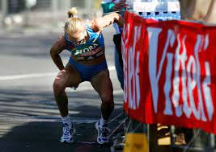
CHARACTERISTICS OF UPF MAY ENHANCE NUTRIENT DELIVERY
SUPERIOR GASTRIC EMPTYING
SUPERIOR INTESTINAL UPTAKE
REDUCED GASTROINTESTINALDYSFUNCTION
REDUCED GASTROINTESTINALLOSSES

Slide 13
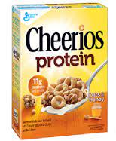
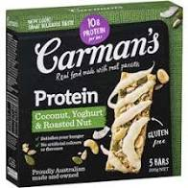
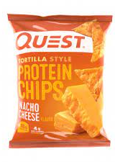
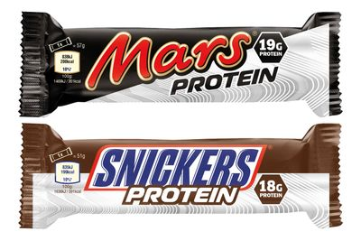
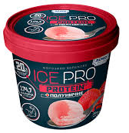
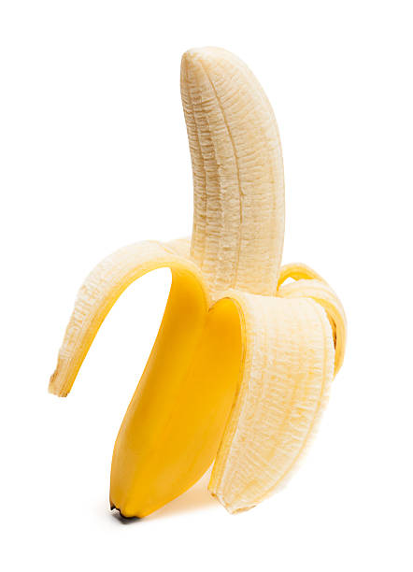
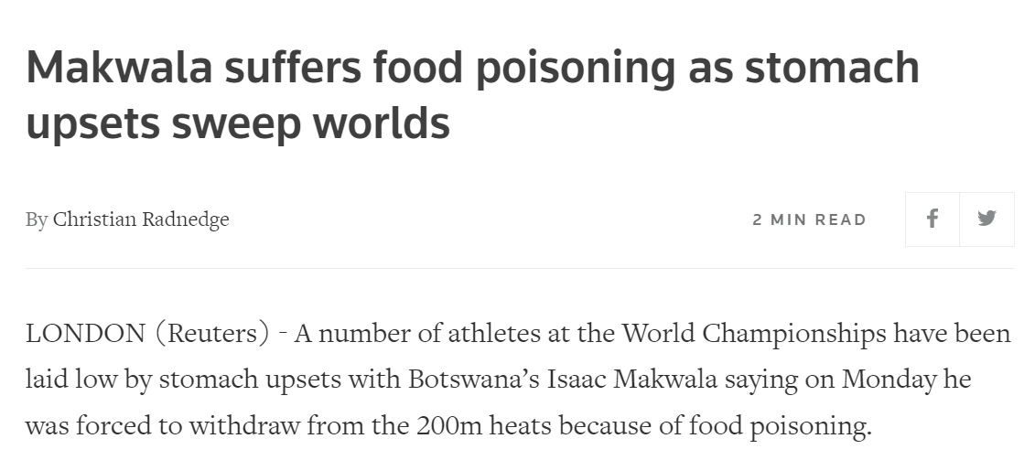
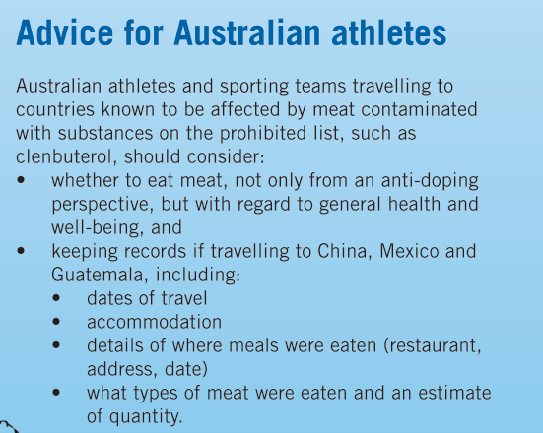
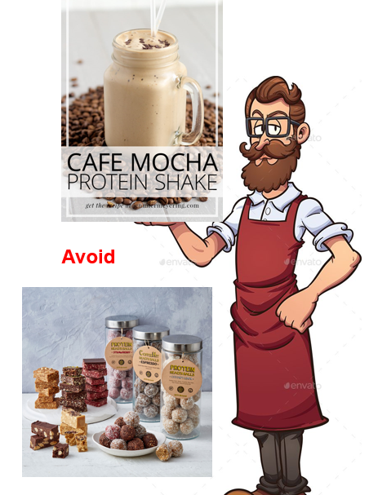
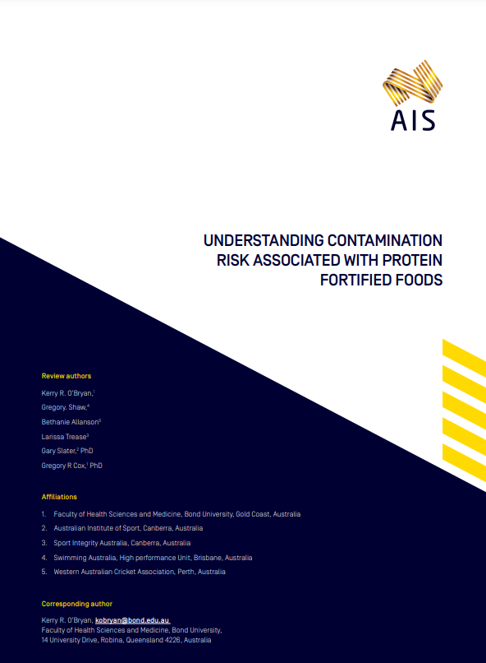
CHARACTERISTICS OF UPF MAY OFFER BETTER SAFETY
BETTER FOOD HYGIENE IN FOREIGN ENVIRONMENTS
BETTER FOOD HYGIENE IN EXERCISE SCENARIOS
ALTERNATIVE TO DOPING- CONTAMINATED FOOD SUPPLY
FUNCTIONAL FORTIFIED FOODS MAY HAVE LOW ANTI-DOPING RISKS
https://www.ais.gov.au/__data/assets/pdf_file/0015/1027230/Protein-Fortified-Foods-Report.pdf

Slide 14
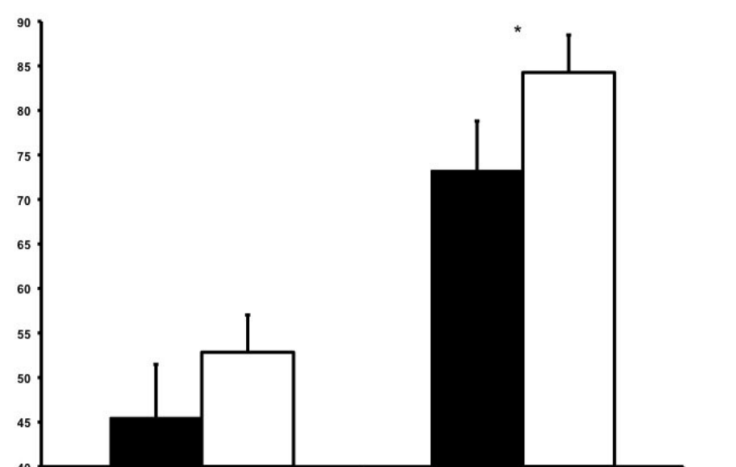
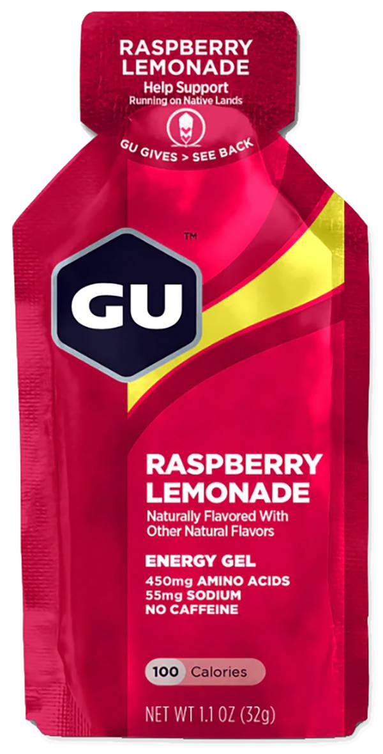
QUIRKY STUDY AWARD!
Post exercise | Sports Supplements
0 hours | Gatorade (600 ml) Kit’s Organic PB 1 x Cliff Shot Bloks
2 hours | Cytomax (1 scoop) Power Bar Recovery Bar Energy Chews
Fast Food
Hotcakes Hashbrown Orange Juice (small)
Hamburger Coke (medium) Fries (small)
Muscle glycogen (mmol/kg ww)
NS
NS
Matched for
Energy (5.5 MJ), CHO (230 g), protein (26 g) and fat (35 g)
2 h recovery 4 h recovery
20 KM Time Trial | 34.1 ± 1.8 min | 34.1 ± 1.8 min
Cramer et al. IJSNEM; 2015, 25: 448-455

Slide 15
UPF HAVE LOWER/ALTERED NUTRIENT DENSITY AND MAY LOSE VALUABLE FOOD CHARACTERISTICS
FOCUSSED ON ISOLATED MACRO TARGETS RATHER THAN “COMPLETE NUTRITION”
REMOVAL OF VALUABLE “FOOD MATRIX”
MULTI-USE OF FORTIFIED FOODS (ESPECIALLY PROPRIETARY BLENDS) MAY LEAD TO OVERCONSUMPTION OF SOME COMPONENTS
FORTIFICATION MAY INVOLVE LIMITED AMOUNTS OF VITAMINS AND MINERALS RATHER THAN “COMPLETE NUTRITION”

Slide 16
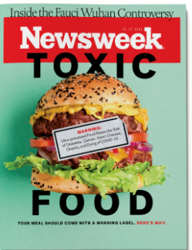
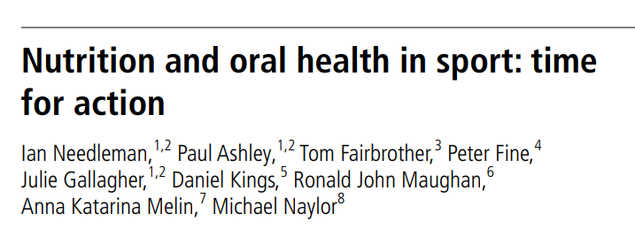
UPF MAY INCREASE RISK OF EXCESSIVE INTAKE OF ENERGY AND “UNHEALTHY” FOOD COMPONENTS/ADDITIVES
Ultraprocessed foods are the perfect storm to promote overconsumption and weight gain: They are laboratory engineered to maximize appeal, are calorie-dense, and have little or no fiber or other healthful nutrients.”
Processed foods contain high amounts of poor-quality fat, added sugar and salt, low amounts of dietary fibers, and a negligible amount of beneficial nutrients
“Ultraprocessed foods include ingredients that are rarely used in homemade recipes — such as high-fructose corn syrup, hydrogenated oils, protein isolates and chemical additives” like colors, artificial flavors, sweeteners, emulsifiers and preservatives,

Slide 17
COSTS OF UPF –
INDIVIDUALLY AND GLOBALLY
SPORTS FOODS ARE TYPICALLY MORE EXPENSIVE THAN AN EVERYDAY FOOD ALTERNATIVE

Slide 18
SOME SPORTS FOODS MIGHT LEAD TO AN ANTI-DOPING RULE VIOLATION
High risk supplements
Muscle gainers and protein supplements
Pre-workouts
Fat “shredders”
Nootropics

Slide 19
HOW SHOULD WE ADDRESS “THE BAD” WITH RESPECT TO SPORTS FOODS AND UPF IN SPORT?
Choose batch tested product where possible
Understand your needs as an athlete and when sports foods are needed/beneficial
Choose batch tested product where possible
Confine the use of ultra-processed foods to scenarios where athletic lifestyle or sports needs make them high value
Choose the least processed version of foods/drinks to provide what you need

Slide 20
HOW SHOULD WE ADDRESS “THE BAD” WITH RESPECT TO SPORTS FOODS AND UPF IN SPORT?
Understand your needs as an athlete and when sports foods are needed/beneficial
Choose batch tested product where possible
Confine the use of ultra-processed foods to scenarios where athletic lifestyle or sports needs make them high value
Choose the least processed version of foods/drinks to provide what you need
When scenarios are more flexible – practise the healthiest options
Consider sustainable food practices in your general life and in relation to sport

Slide 21
Ultraprocessed foods have contributed to confusion, the diet wars and a loss of belief in nutrition science
BurkeGPTTM
A new diet appears
A plausible theory
Rules
Focus on whole foods
Eat adequate quality protein
Eat plenty of vegetables
Prioritise nutrient density
Eat slowly to satisfaction
We’re
over it
Falling
in Love
The life cycle of a diet
(Burke’s Law)
Many people adopt it
It works!
Early
Main-
stream
Saturation-
Tipping
Point
Reduced food availability = reduced energy intake

Slide 22
Ultraprocessed foods have contributed to confusion, the diet wars and a loss of belief in nutrition science
BurkeGPTTM
There is now a commercial opportunity for this diet
We’re
over it
Food industry creates bespoke foods for this diet
The life cycle of a diet
(Burke’s Law)
Food availability is restored
Bespoke foods are UPF
Saturation-
Tipping
Point
The diet stops “working”

Slide 23
How it started
How it’s going
Grass-produced meats
Fish/seafood
Fresh fruits and veggies
Eggs
Nuts and seeds
Healthful oils (olive, walnut, flaxseed, macadamia, avocado, coconut)
Raw honey
Grade B maple syrup
Molasses
Stevia
Agave
Coconut sugar
Palm sugar
Weight loss and metabolic rate

Slide 24
How it started
How it’s going
#LCHF
Pre-training:
Bullet Proof coffee
Long training
Cheese, peanut cookies, electrolytes
Post training
Whey and cream shake
Breakfast
Eggs and hollandaise sauce
Lunch
Fatty mince “tacos” in lettuce shells + cheese + sour cream + avocados + dressed salad
DInner
“risotto” made with cauli rice + coconut cream + salmon + vegetables
Dessert
Berries + cream
Snacks
Nut balls + free vegies

Slide 25
How it started
How it’s going

Slide 26
NutriNet-Santé cohort
Web-based survey
Greater use of UPF associated with
Recent onset of adopting non-meat diet (p< 0.001)
Age at adopting non-meat diet (p< 0.001)
21,212 Participants | Meat eaters | Pesco vegetarians | Vegetarians | Vegans
Number | 19,812 | 646 | 500 | 254
% energy from UPF | 33.0 | 32.5 | 37.0 | 39.5

Slide 27
How it started
How it’s going

Slide 28
WHAT EVER DIET RELIGION YOU BELONG TO….
BE YOUR BEST SELF!
BurkeGPTTM

